Slide 1
INF 3075 : Software testing and quality assurance TD1
Instructor : Dr KIMBLI

Slide 2
Name of participants
MATRICULES | NAMES
19M2392 | TCHINDE WAFFO Cyrille-Junior
18T2647 | MAYOGUE TADJUIDJE Paulette
19M2143 | OUABO Samuel Jordan
18T2890 | NSANGOU Adamou
18T2419 | NDANG ESSI Pierre Junior

Slide 3
WORKPLAN
I- Test case document for TCAS project
II - Student result managment system

Slide 4
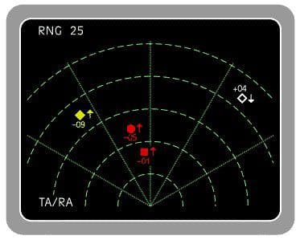
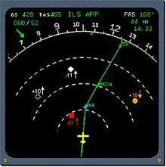
I- THE TEST CASE DOCUMENT FOR TCAS PROJECT

Slide 5
1) requirements specifications
REQUIREMENT | REQUIREMENT ID
Detect devices with an active transponder located within a well-defined perimeter | 1
Interrogate and monitor a maximum of devices (45) over a very short time interval | 2
Delimit the areas in which there will be an alert and not if there was a device detected | 3
Define different type (Approach Traffic, Traffic Advisory, Resolution Advisory) of alert that will be emitted depending on the position of the approaching / surrounding device | 4

Slide 6
2) Test case document
TestCase ID | TestCase Description | Precondition | Test Input | Expected result
TC1-TCAS | Make simulations with devices | Have devices of at least 19 places and of 5700kg | Transponders and TCAS | TCAS detects all devices that are within its detection perimeter
TC2-TCAS | Perform a simulation to see the number of devices that a TCAS can track | Have devices equipped with transponder and TCAS | Flight simulator, transponder, TCAS | Be able to detect and monitor a minimum of 45 devices equipped with a transponder

Slide 7
II- STUDENT RESULT MANAGMENT SYSTEM

Slide 8
1) The seven principle of software testing explicity with respect to SRMS
Testing shows that there are faults in the system:
Example: If in the general result list, a student is seen ADMITTED, whereas he is not, this shows that there is a fault in the system.
Exhaustive testing is impossible:
Example: We cannot test the system with all the students of UY1.
Test early:
Example: The functionalities should be in ascending order of their development, and tested as such. For example, test ADD A STUDENT functionality before ADD A MARK functionality.
Grouping of faults:
Example: If in the system a student is having 2.00 average, and he is given a “EXCELLENT” appreciation, we will conclude that the appreciations functionality is faulty.

Slide 9
1) The seven principle of software testing explicity with respect to SRMS
Paradox of Pesticides:
Example: If we keep testing several times a specific module, at a moment that module no more generate errors. By doing so, we can forget errors from other modules.
Testing is context dependent:
Example: It has no sense to test the average calculation functionality on a student which is having no mark.
Fallacy of the absence of errors:
Example: If we test the average calculation functionality on 100 students and it works well, this does not mean that the functionality is not having errors, just that we have not yet found the student that will make it generate errors.

Slide 10
2) Six principales of black box testing techinics

Slide 11
3) The concept of test case document with respect SRMS
a) Requirement specification
b) Test case document

Slide 12
a) Requirement specification
MODULE | REQUIREMENT | REQUIREMENT ID
User Management | create user’s account in the system | 1
 | Log in | 2
 | Modify user’s informations | 3
 | Find user’s account | 4
 | Delete user | 5
Faculty Management | create a faculty/sector/level /speciality/subject in the system | 6
 | Modify informations of faculty/sector/level /speciality/course | 7
 | Find a faculty/sector/level /speciality/course | 8
 | Delete a faculty/sector/level /speciality/course | 9

Slide 13
b) Test case document
TestCase ID | TestCase Description | Precondition | Test Input | Expected result
TC1-TCAS | Make simulations with devices | Have devices of at least 19 places and of 5700kg | Transponders and TCAS | TCAS detects all devices that are within its detection perimeter
TC2-TCAS | Perform a simulation to see the number of devices that a TCAS can track | Have devices equipped with transponder and TCAS | Flight simulator, transponder, TCAS | Be able to detect and monitor a minimum of 45 devices equipped with a transponder
TC3-TCAS TC4-TCAS TC5-TCAS | Simulate the movement of aircraft on specific areas | Have aircraft equipped with transponders and TCAS | A flight simulator, able to simulate the movement of aircraft | Issue a specific type of alert (audible or visual) according to the different positions occupied by aircraft

